Slide 1
Track Reconstruction for a High-Luminosity LHC Detector using Deep Neural Networks
Luiza Adelina Ciucu
University of Geneva
Master Thesis Defence
March 2021

Slide 2
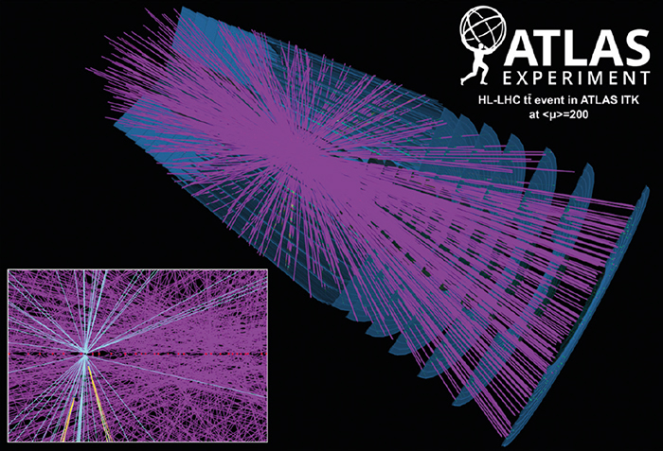
Very complex combinatorics for track reconstruction at HL-LHC.

Slide 3
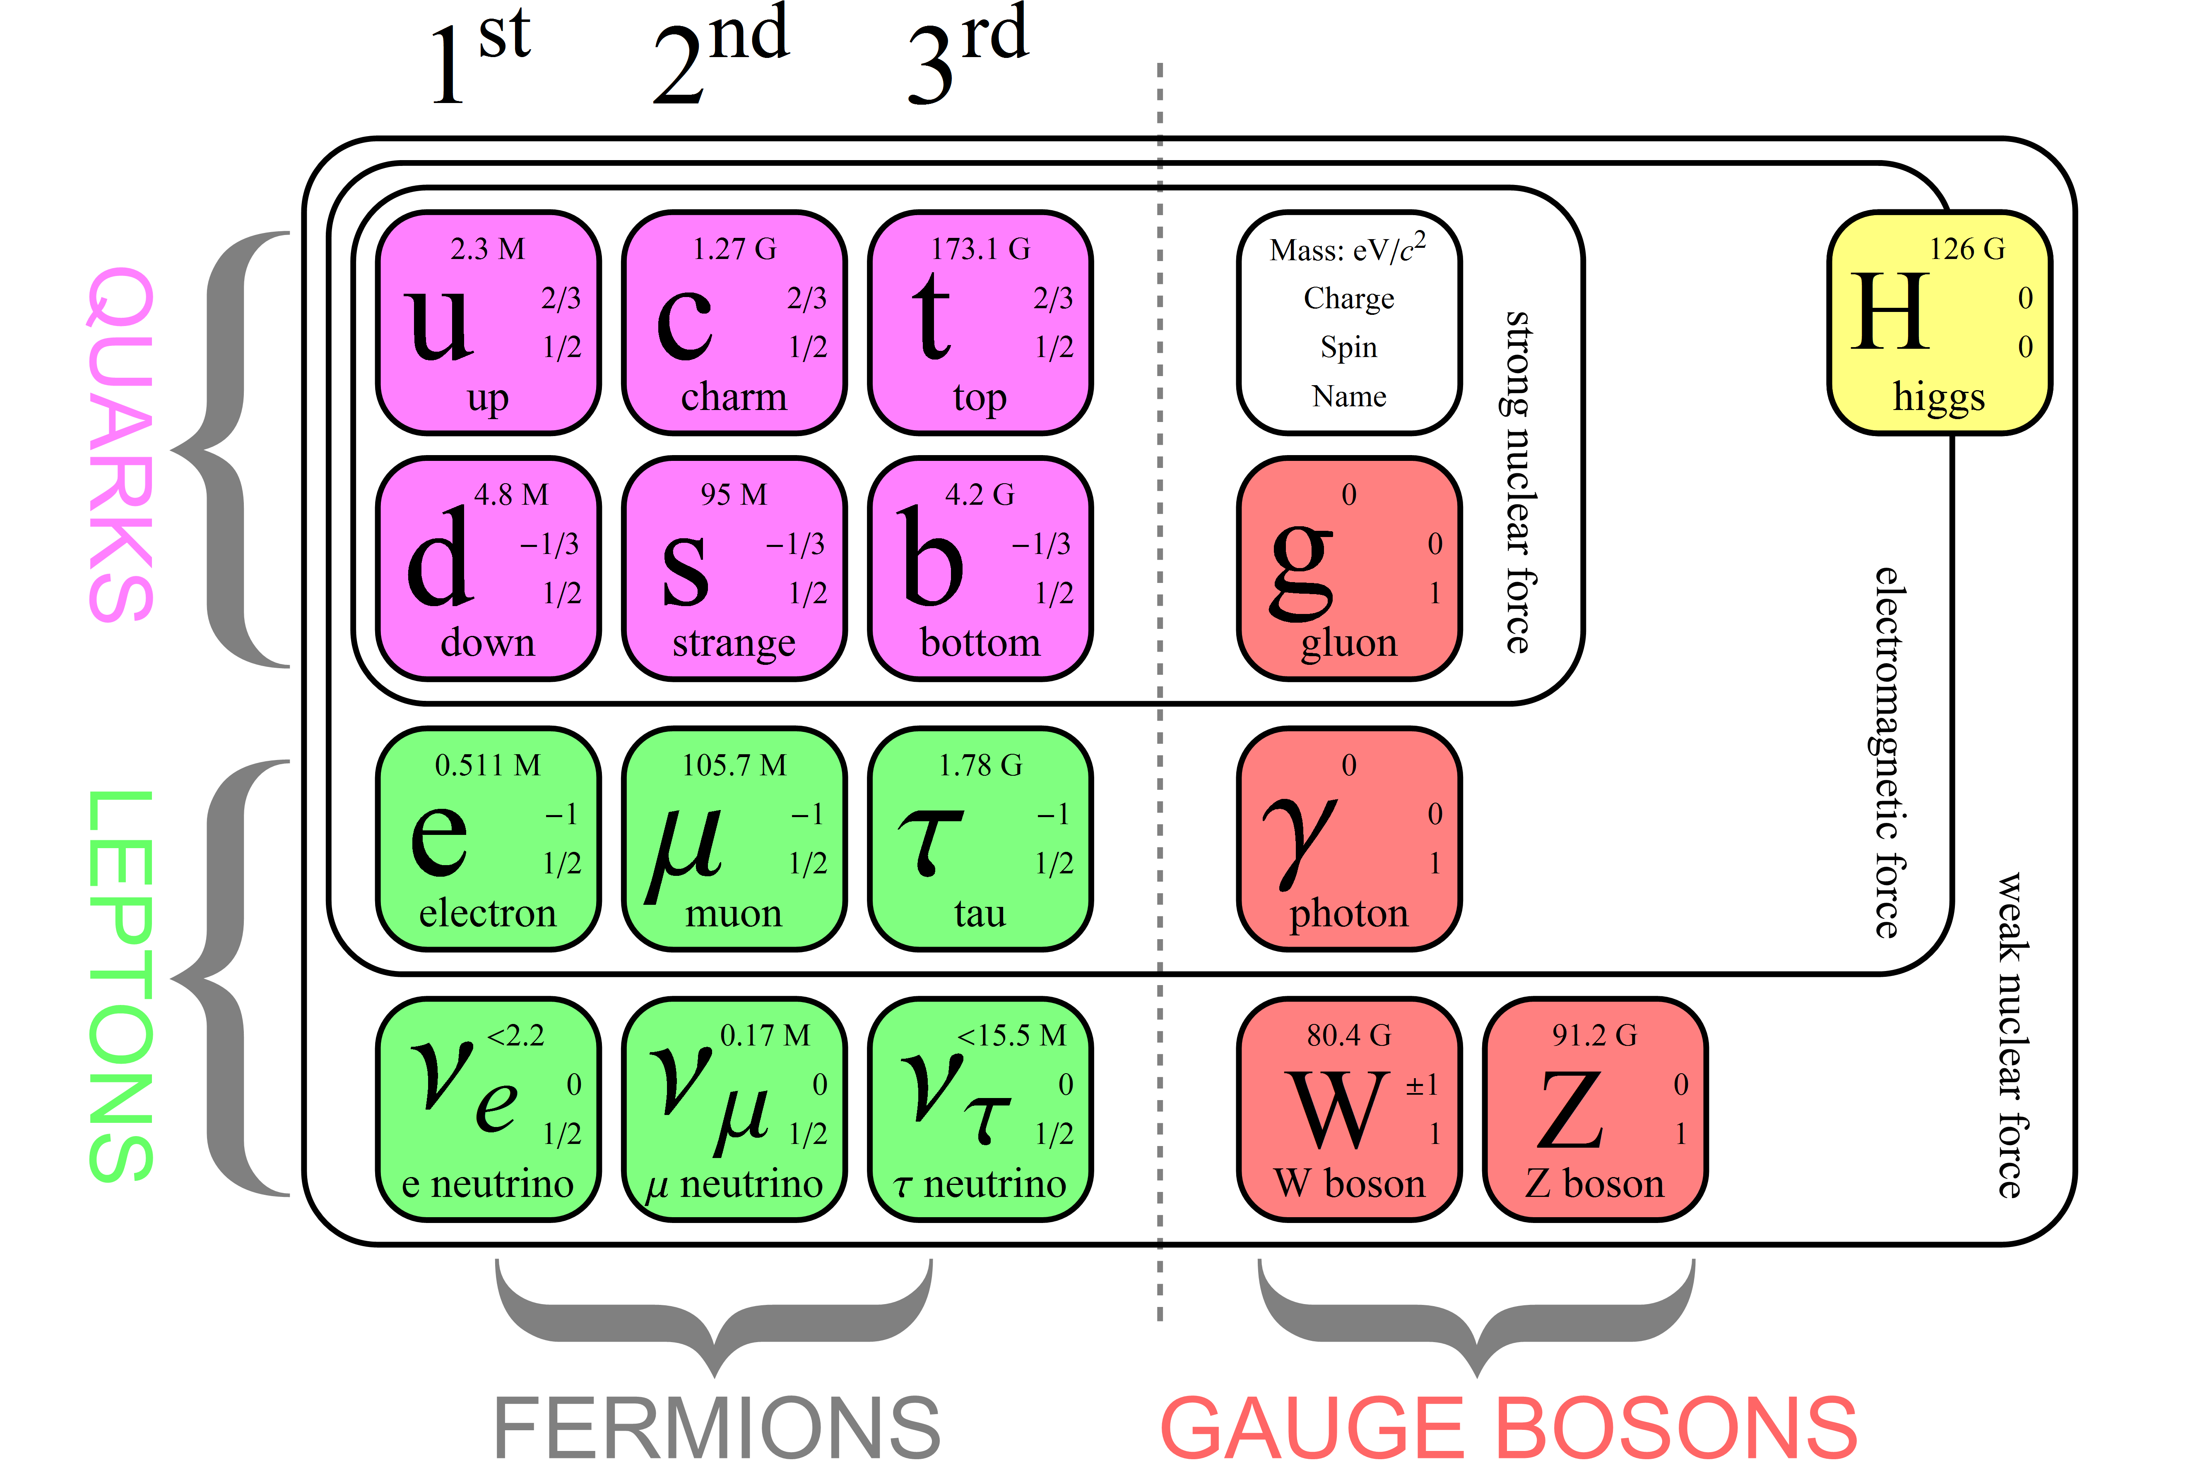
The Standard Model studies elementary particles & their interactions.

Slide 4
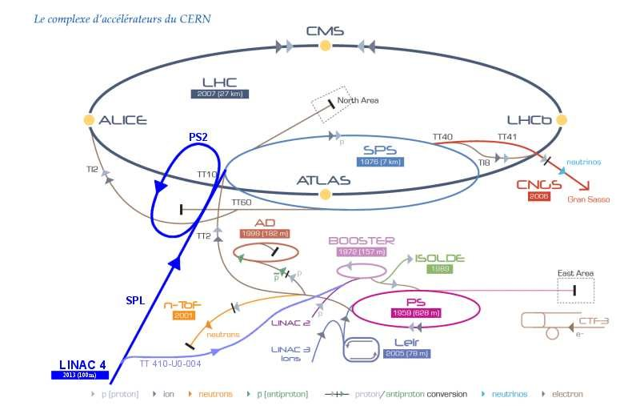
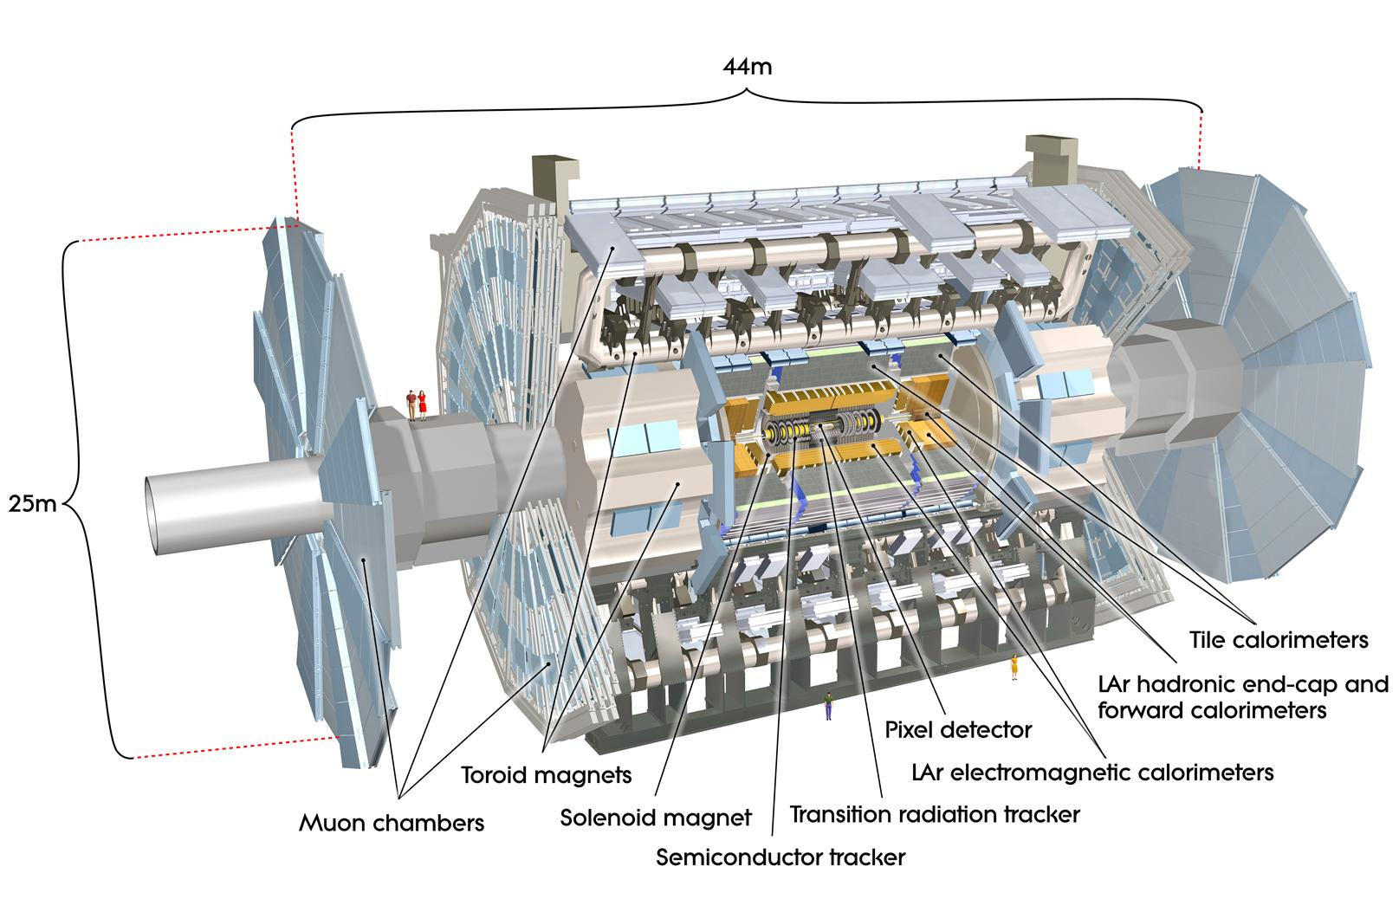
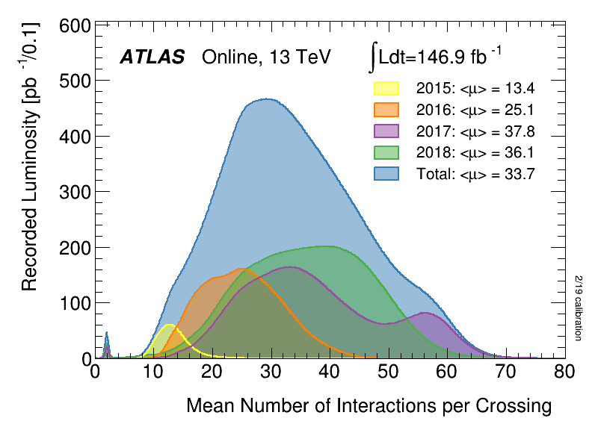
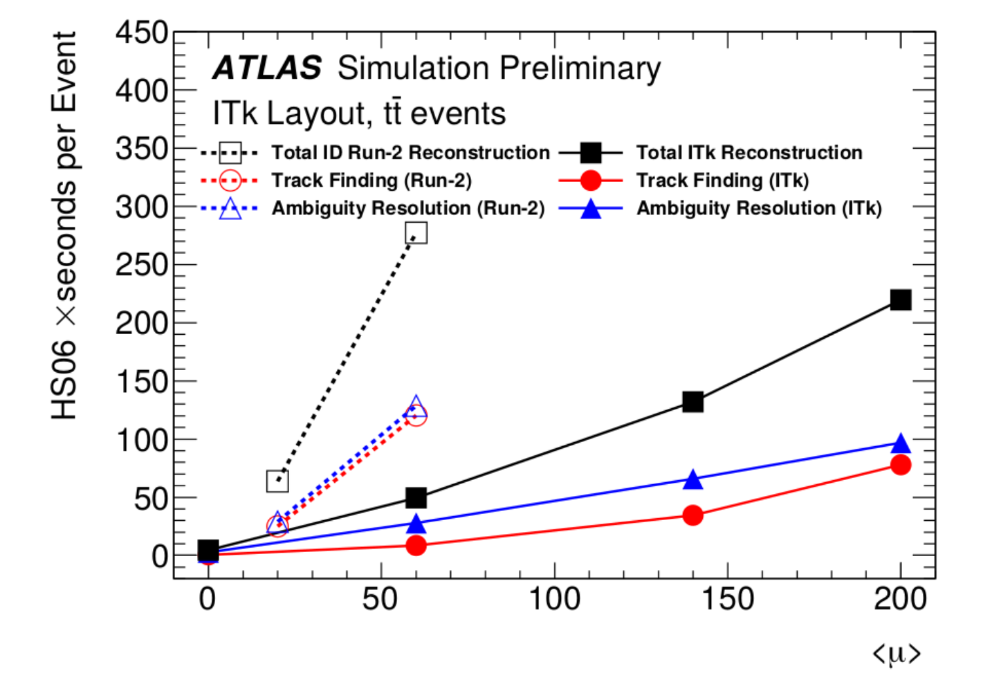
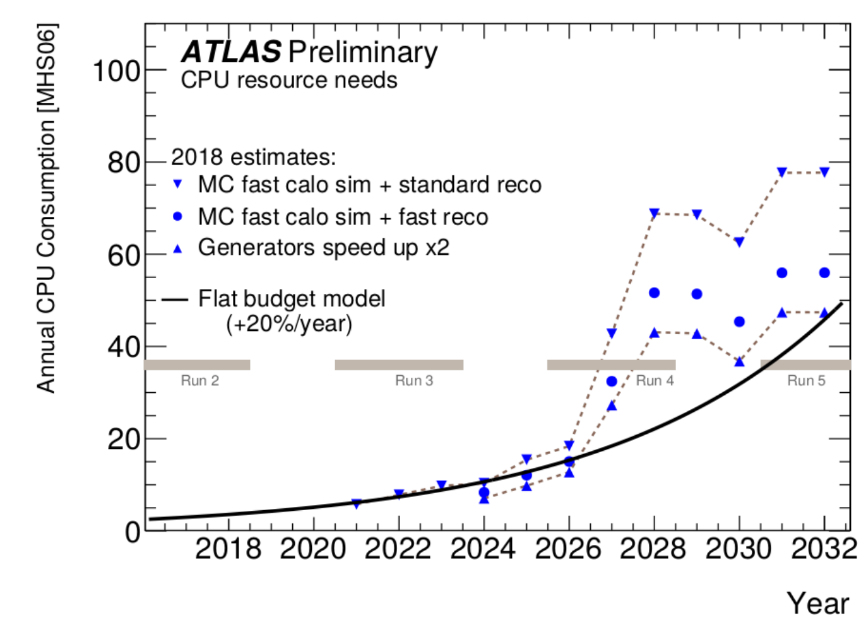
LHC experiments have typically 35 collisions per bunch crossing (mu=35), but plan to go to mu=200 for HL-LHC.
At mu=200 track reconstruction needs CPU beyond LHC resources.
A potential solution is to use new techniques like machine learning.

Slide 5
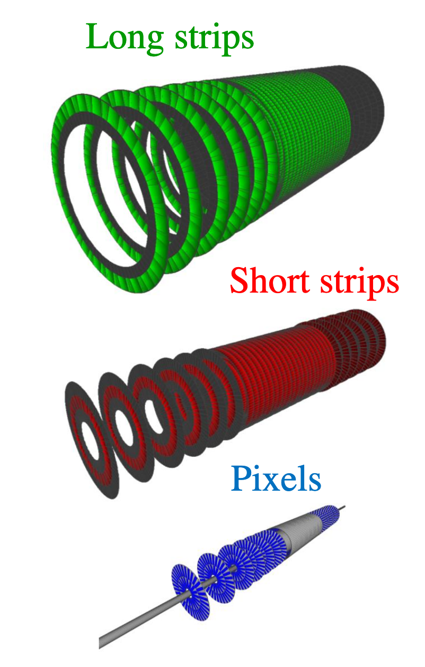
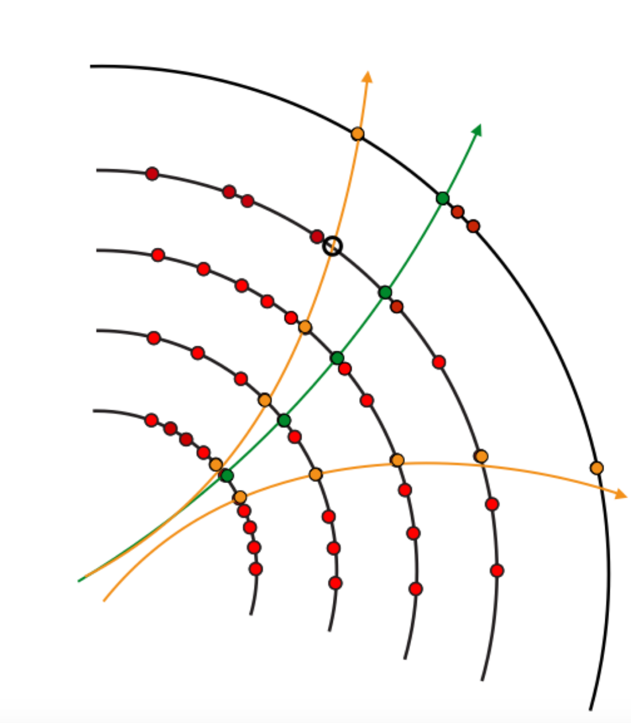
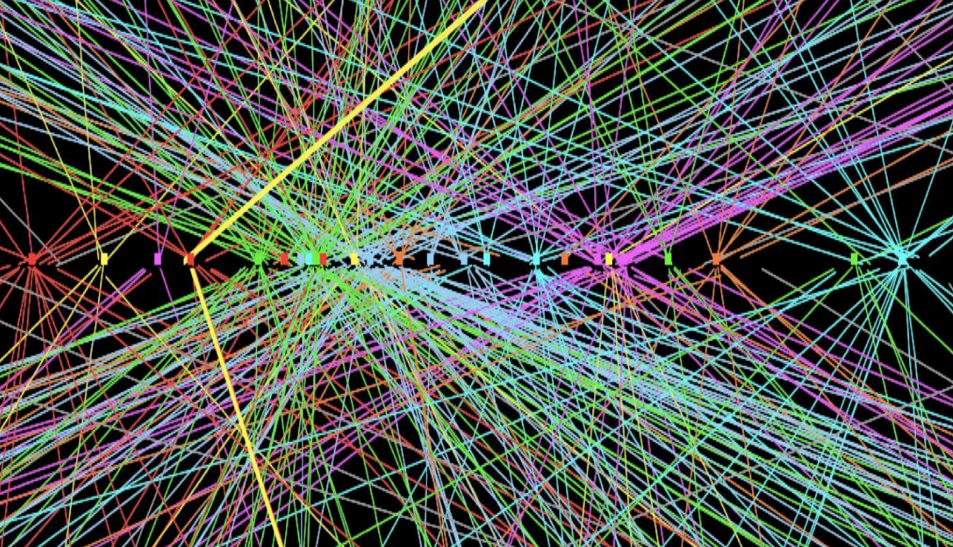
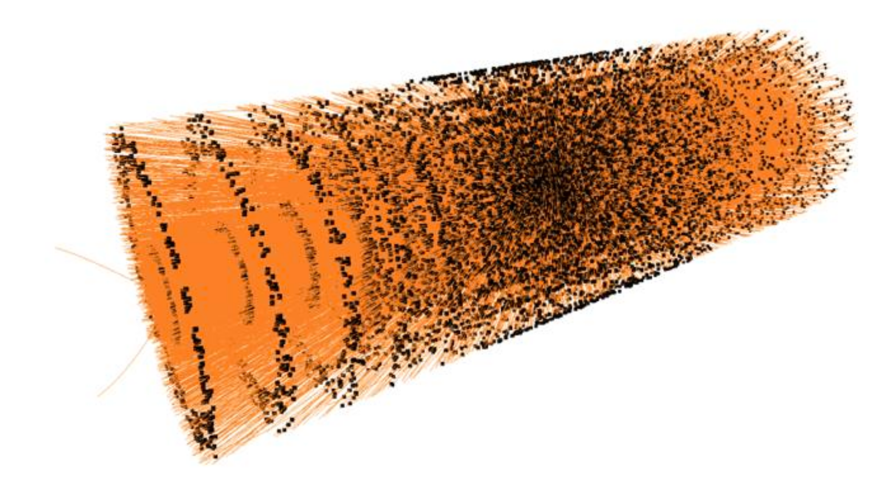
The TrackML challenge offers simulated ttbar collisions at mu=200.
From hits in the inner detector are reconstr. primary vertices & tracks.
Vertex reconstruction
Track reconstruction
Orange tracks reconstructed
from black hits.
3 silicon detectors in the inner detector

Slide 6
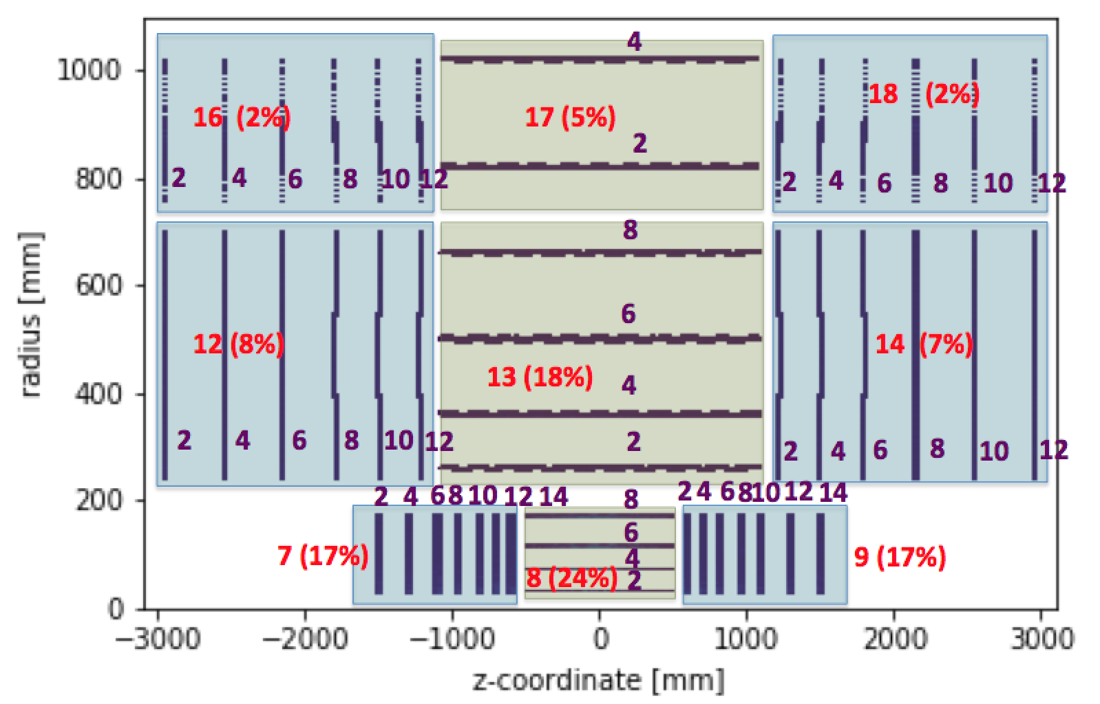
Barrel (with horizontal layers). End caps (with vertical layers).
The detector’s volume_id in red, and the layer_id in violet.
Percentage of hits in a volume_id shown in parentheses.

Slide 7
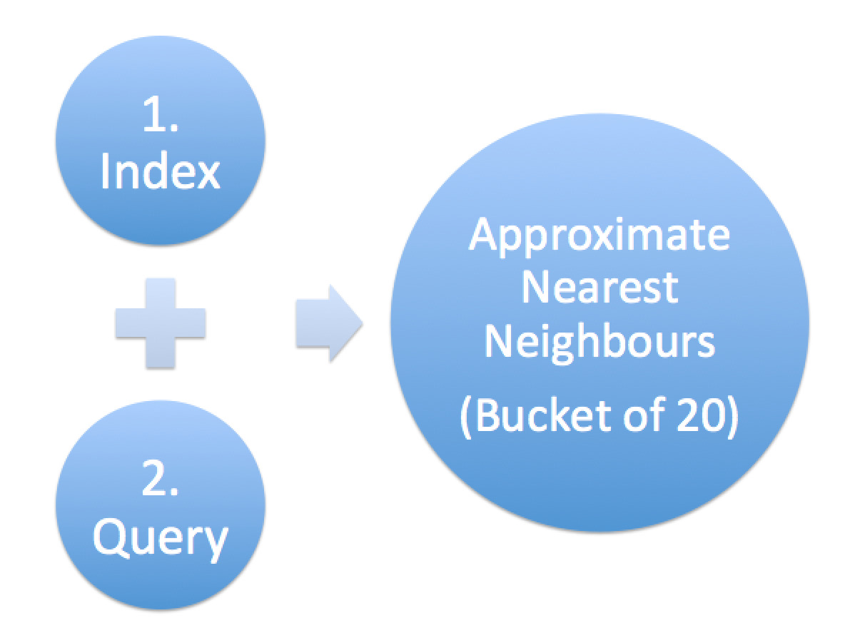
Distribution of number of hits in truth particles.
Reconstructed hits into buckets using approximate nearest neighbors.
Truth level
Reconstructed level
An average truth particle as 11 hits. All particles have less than 20 hits.
We aim to reconstruct particle tracks from groups of 20 hits close to a straight line (bucket).

Slide 8
Buckets with 1-9 number of positive hits are artificially set to 0 positive hits. Reason is that we search for particles with at least 10 hits.
Majority particle = truth particle with the largest number of hits in the bucket
Positive hit = 1 = hit belonging to the majority particle
Negative hit = -1 = hit not belonging to the majority particle
Y coordinate = number of hits (histogram)

Slide 9
Problem to solve: Given a bucket of 20 hits,
identify those hits belonging to the particle
with the largest number of hits in the bucket (majority particle).
Multi-label
Several questions simultaneously (one for each hit)
Classification
The questions have categorical answers (yes or no)
Binary
Only two categorical labels: yes or no (1 or -1)
For a bucket input and out fixed: Input = 20x3 (x,y,z). Output = 20x1.
This problem can be answered via machine learning (ML),
In particular deep neural networks (DNN).

Slide 10
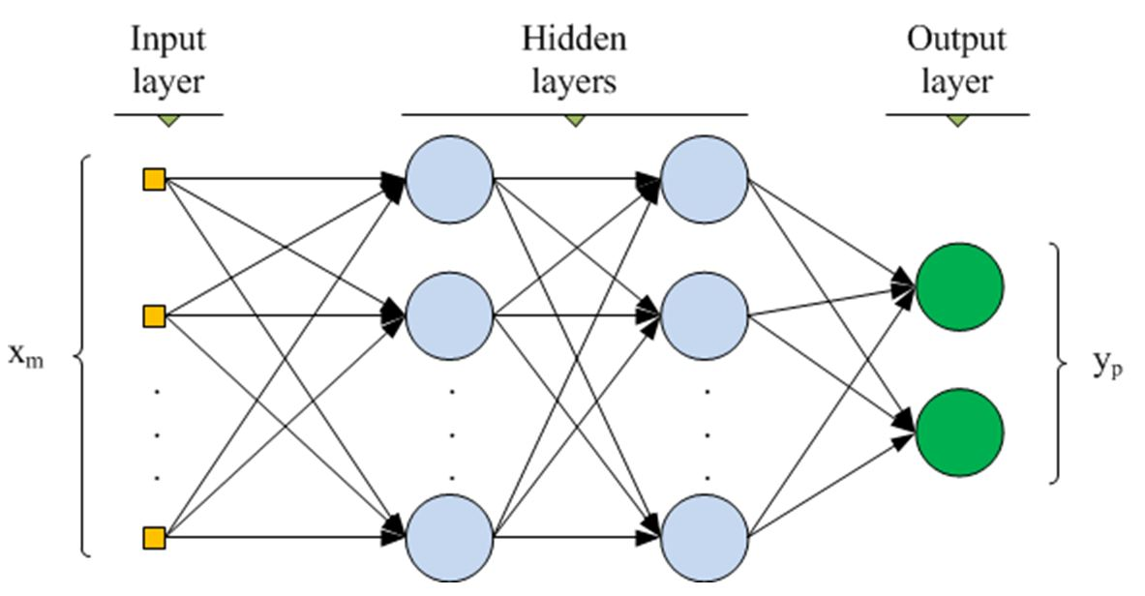
The question we try to answer: find the function using a deep neural network (DNN) that for each bucket (of 20 hits) has the following input and output structure:
input | (x,y,z)_1 | (x,y,z)_2 | (x,y,z)_3 | … | (x,y,z)_18 | (x,y,z)_19 | (x,y,z)_20 | 60 elem
Output | 1 | -1 | 1 | … | -1 | 1 | 1 | 20 elem

Slide 11
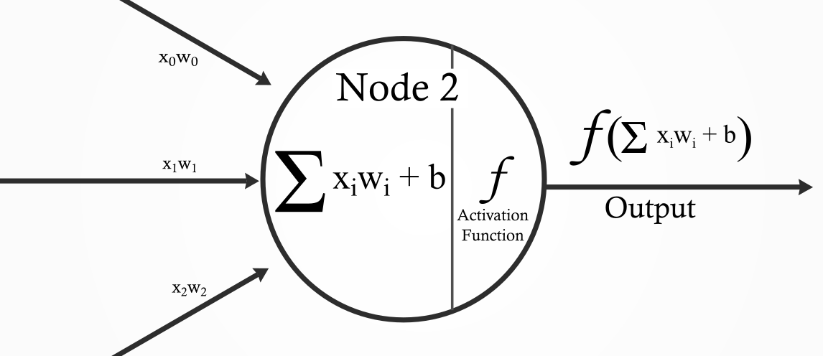
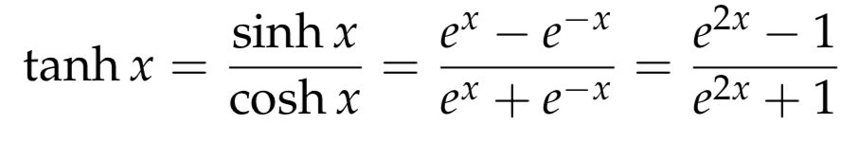
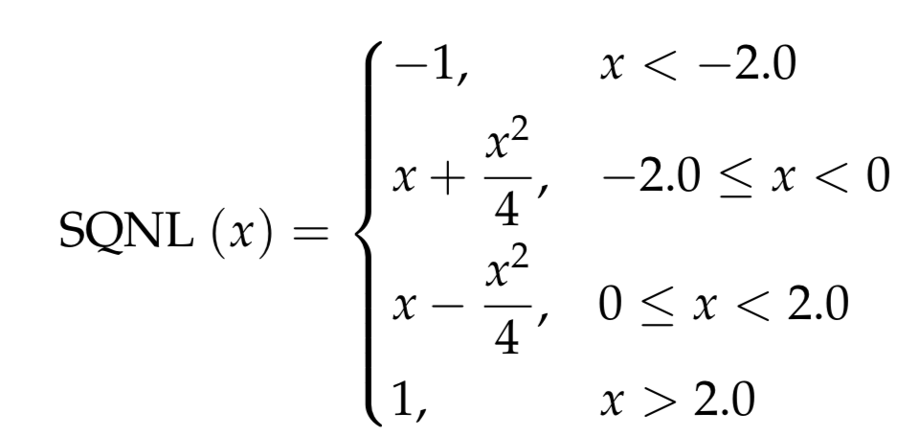
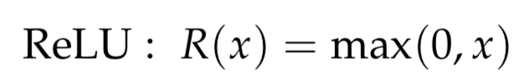
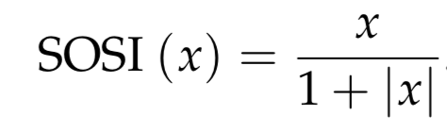
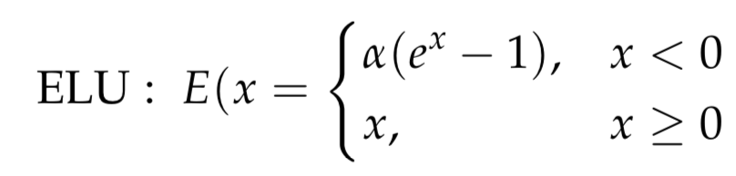
One neuron: inputs, bias, activation function, output
Activation functions for the hidden layers and for the last layer.

Slide 12
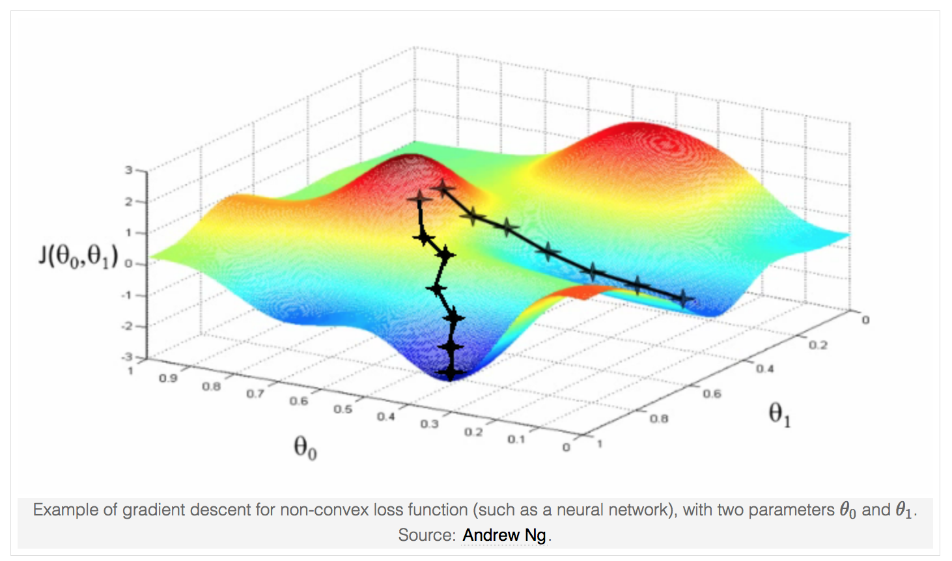
A NN learns by minimizing the loss function via gradient descent
and back propagation.
Like water falling off a mountain
at every turn on the steepest slope.
Partial derivative of the loss
function w.r.t. weights and biases,
Using optimisers like Adam & Adadelta.

Slide 13
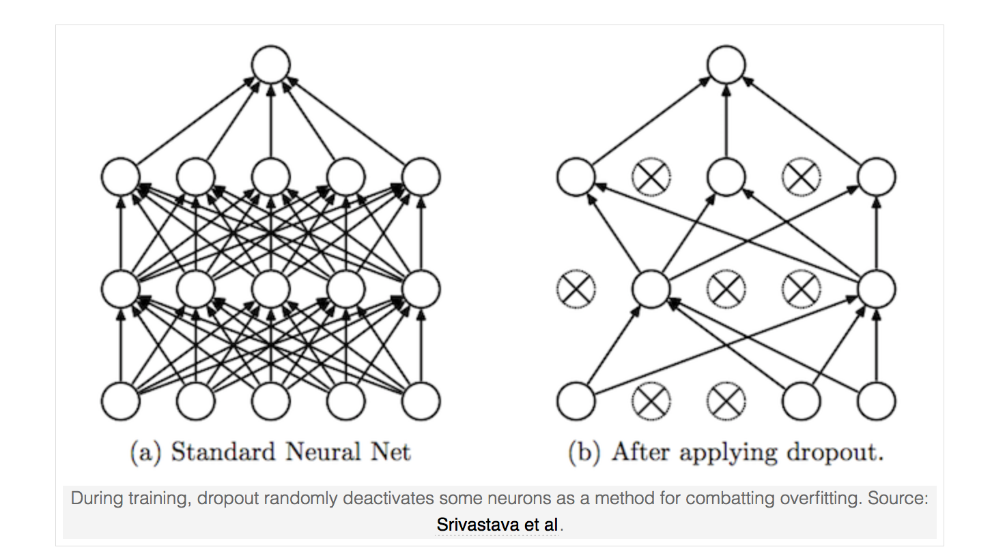
Dropout is a technique during training to drop randomly some percentage of nodes, to avoid over-fitting. We use it with fraction 20%.

Slide 14
Examples of hyper-parameter tuning for dropout layer & loss function.

Slide 15
Hyper-parameter tuning and the resulting best model.
Hyper-parameter | Several choices testted | Choice for best model
Number nodes per input layer | 20x(x,y,z)=60 | 20x(x,y,z)=60
Number nodes per output layer | 20 | 20
Number hidden layer | 2, 3, 4 | 3
Number nodes per hidden layer | 20x3, 20x6, 20x10, 20x14 | 20x10
Activation function input | Linear | Linear
Activation function output | TANH, SQNL, SOSI | TANH
Activation function hidden | eLU, ReLU | ReLU
Dropout layer | no, yes | yes
Loss function | Squared Hinge, Regular Hinge | Regular Hinge
Optimizer | AdaDelta, Adam | Adam
k-fold | 50% Train, 50% Test 70% Train, 30% Test | 70% Train, 30% Test

Slide 16
Train in balanced to have equal numbers of positive & negative hits.
Set 10-17 to same value of 17, then reduce at 0. Test stays unbalanced.

Slide 17
Confusion matrix:
21 x 21
Train balanced:
Peak is along the diagonal.
Test unbalanced
Less clear, somewhat diagonal.

Slide 18
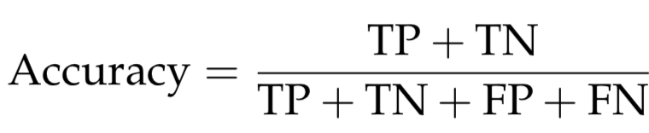
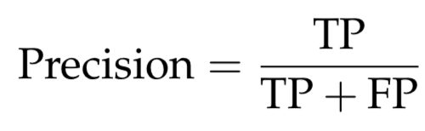
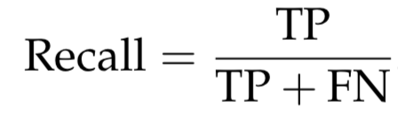
Metrics for hits per volumID: accuracy, precision, recall.
Confusion matrix for one hit.
True Positive (TP) | False Positive (FP)
False Negative (FN) | True Negative (TN)
Accuracy not useful when unbalanced dataset.
Then better use precision and recall.
There is a precision-recall trade-off.
Then can not be both max (1) at the same time.

Slide 19
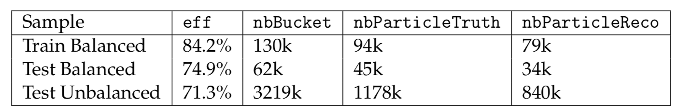
Efficiency of track / particle reconstruction is about 70%.
Buckets with one truth particle,
i.e. with at least 10 positive hits
All buckets
Buckets with one truth particle and in addition with 80% of its positive hits correctly reconstructed
nbParticleTruth = subset of buckets with at least 10 positive hits
nbParticleReco = subset of nbParticleTruth with at least 80% of positive hits
reconstructed also as positive hits (nbTruePositiveHits / nbPositveHits > 80%)
rrack / particle reconstruction efficiency = nbParticleReco / nbParticleTruth

Slide 20
Conclusion: Results and future plans.
Context
Tracking is key for charged particle reconstruction in inner detector
Problem
Given an event, create groups of 20 hits called buckets, with hits aligned in the same direction using approximate nearest neighbor methods
For each hit in a given bucket, predict if it belongs or not to the particle with the largest number of hits (majority particle). Positive hits belong to the majority particle.
Solution
Problem solved with machine learning (ML), in particular deep neural network (DNN).
Events split 70% in train, 30% in test
Tracking at pile-up mu=200 at HL-LHC requires more CPU than CERN resources
It is a multi-class binary classification problem.
Buckets with nbPositiveHit < 10 are set to nbPositiveHit=0
Train sample leveled 10-17 and then balanced positive and negative hits.
Hyper-parameters are tuned.
Results
Track/Particle-level metrics: Reconstruction efficiency ~ 70%.
Hit-level metrics: Accuracy ~ 65% Precision ~ 30%, Recall ~ 70%.
Future Plans
Improve model by using more events, better hyper-parameter tuning, new models.
Input = 20 x 3 (x, y, z). Output = 20 x 1 (1 or -1).
Study performance for various particle directions and momenta within the detector

Slide 21
Backup slides

Slide 22
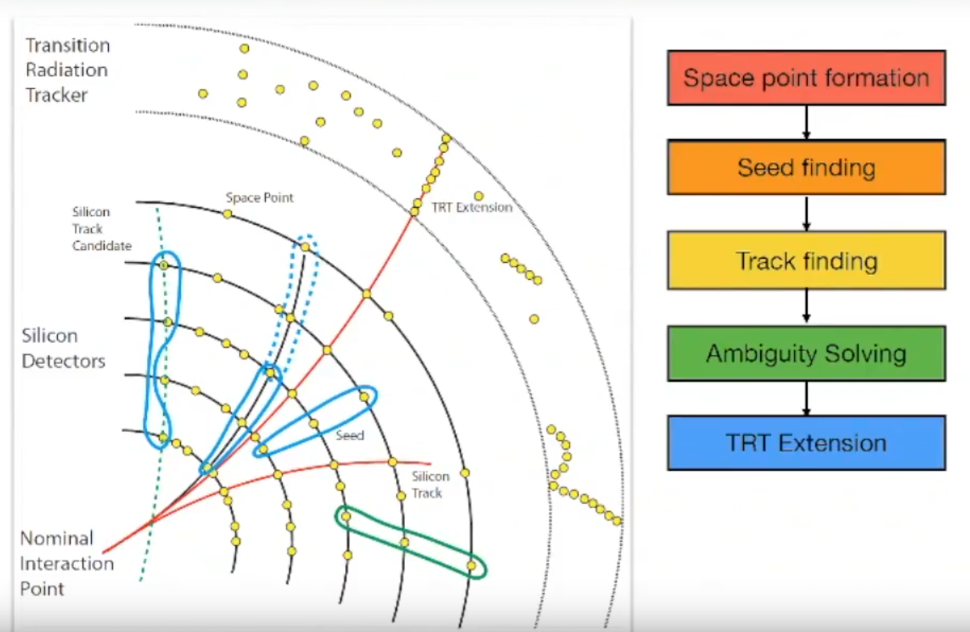
LHC detectors reconstruct and measure the kinematic properties of particles produced in proton-proton collisions. Charged particles ionize matter, producing hits in the various layers of the inner detector.
Our task is to reconstruct tracks from hits.

Slide 23
Schematic view of the general inner detector with layers.
Charged particles leave tracks
after starting in the central layer closest to the beam.
End cap
Barrel
End cap
p
p

Slide 24
NN learning optimizers: Adam vs Adadelta
Adam optimization is a stochastic gradient descent (SGD) method that is based on adaptive estimation of first-order and second-order moments.
ADAM = Adadelta + Stochastic Gradient Descent (SGD) + Momentum
AdaDelta = rescales gradients based on accumulated second order information
Momentum = smoothens gradients based on first order information
Alpha = 0.001 (learning rate)
Beta_1 = 0.9 (The exponential decay rate for the 1st moment estimates.)
Beta_2 = 0.999 (The exponential decay rate for the 2nd moment estimates.)
Adadelta is a more robust extension of Adagrad that adapts learning rates based on a moving window of gradient updates, instead of accumulating all past gradients.
alpha = 0.001 (learning rate)
rho = 0.9 (The exponential decay rate for the 1st moment estimates.)
In this study various learning rates were tried, but no change was observed.
So the default learning rate of 0.001 was used.
Adam was chosen for the best model.

Slide 25
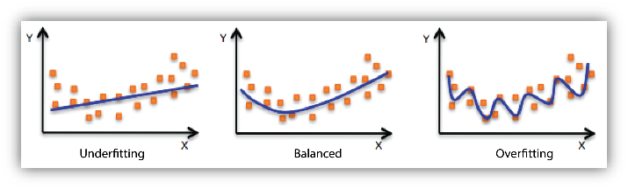
Over-fit (over-train) vs under-fit (under-train)
Under-fit: model performs bad in training data. The model is too simple. Solution:
Add more relevant features correlated to the target.
Reduce regularization.
Over-fit: model performs well in training data, but bad in test data. Model memorizes the behavior of training data and is not able to generalize in test to new data slightly changed. Solution is to reduce the model flexibility by:
Use fewer features
Use fewer bins per features
Increase regularization
If both train and test data performance are bad:
Increase the amount of training data samples
Increase the number of epochs

Slide 26
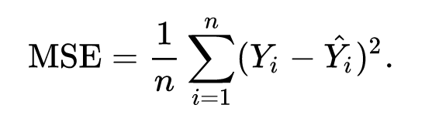
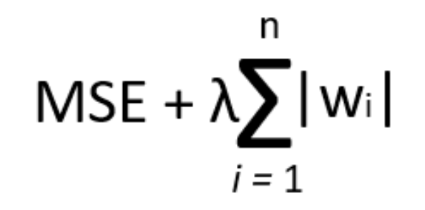
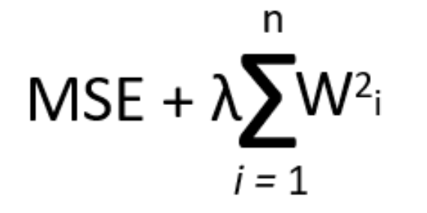
Regularization methods to avoid over-fitting
Regularization techniques add to the loss function which modifies the resulting weights.
In this project we did not use regularization, but also did not notice over-fitting, as performance in test is similar to the performance in train.
What is minimized actually is the
cost function = loss function + regularization term
Typical loss function: mean squared error (MSE)
L1 regularization: cost function = MSE + L1 Regularization
L2 regularization: cost function = MSE + L2 Regularization

